Slide 1
Miller Rocks Gulls
Bob Cordie
Biologist
The Dalles Lock and Dam
Sept 26, 2018

Slide 2
Miller Rocks
Located between The Dalles and John Day
Disconnected from Miller Island
Avg ~4,400 California Adult Gulls (range ~3,500 – 6,000)
Ownership?

Slide 3
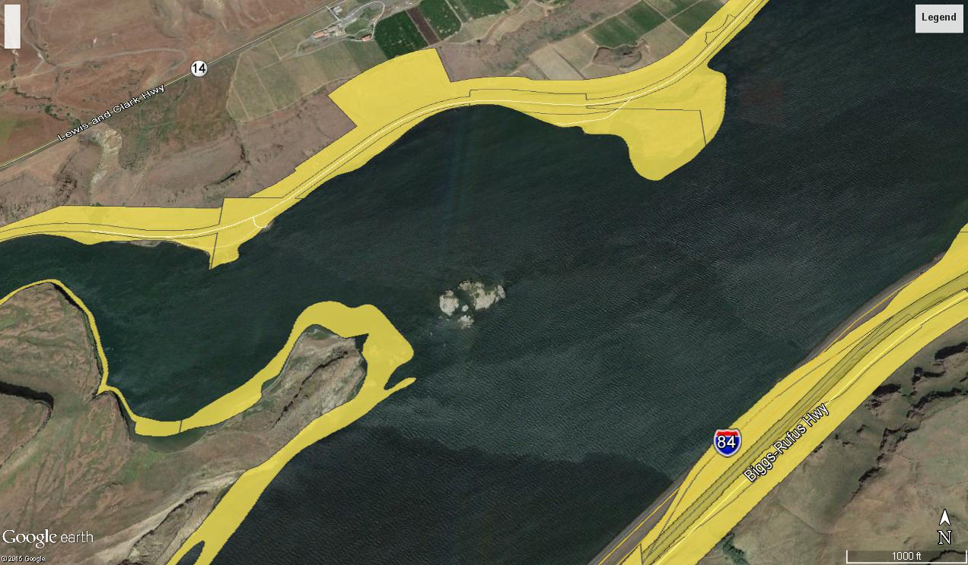
Miller Colony

Slide 4
BiOp Juv Passage Requirements
Smolt survival 96% Spring & 93% Summer
Inland Avian Reasonable & Prudent Alternatives
  47. Manage avian predators on Corps lands
  48. Continue deterrent efforts – (lines, hazing)
  68. Monitor avian predators & smolt impacts – (daily inspections, status reports)
Notes:
Focus detterents and monitoring.

Slide 5
Avian Abatement Efforts
History
  12months lethal removal 1995 - USDA
  Lethal for all species (except Bonaparts gulls)
  Arbitrary bag limit restrictions via FPOM
  Lack of NEPA compliance
  No lethal after NEPA attempt
Avian Lines – limited effectiveness
Hazing Apr 15 – July 31 – limited effectiveness
Flow Dependent

Slide 6
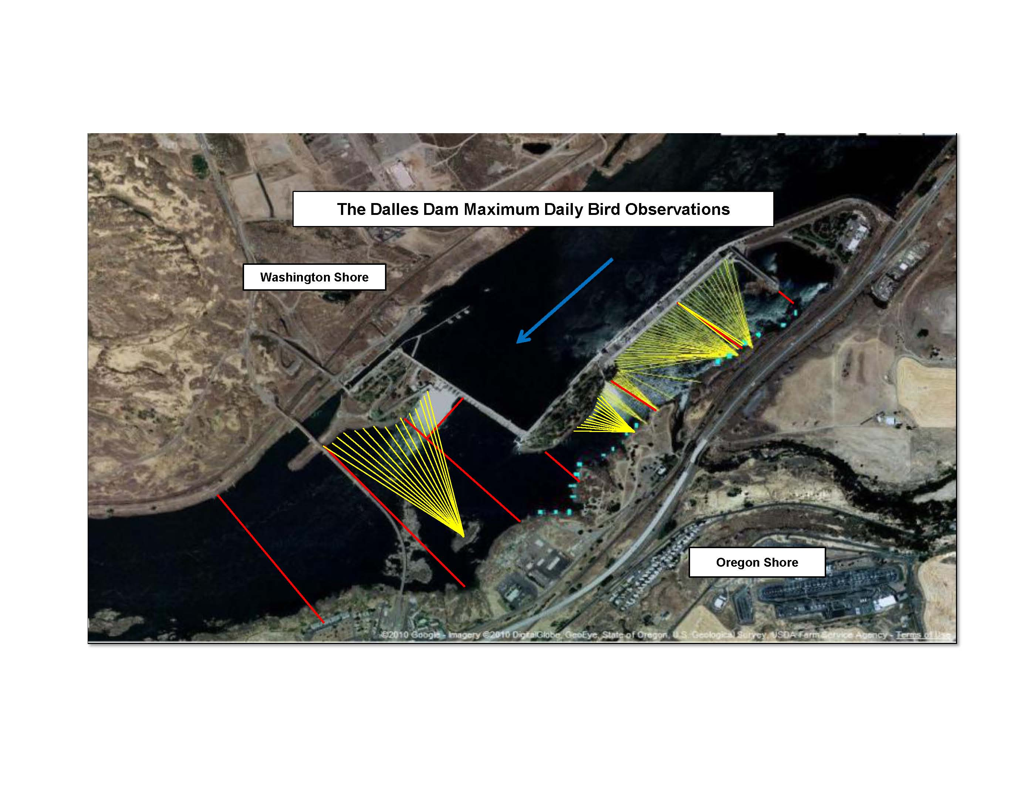
Present Avian Line Grid
Notes:
RPA detterent. Present grid. Best detterent to date. Challenges; falcon listing/bridge attachment/falcon nest/BRZ only.. Note westrick, sluiceway and powerhouse…

Slide 7
Notes:
‘11 high flow year. Continued increase.

Slide 8
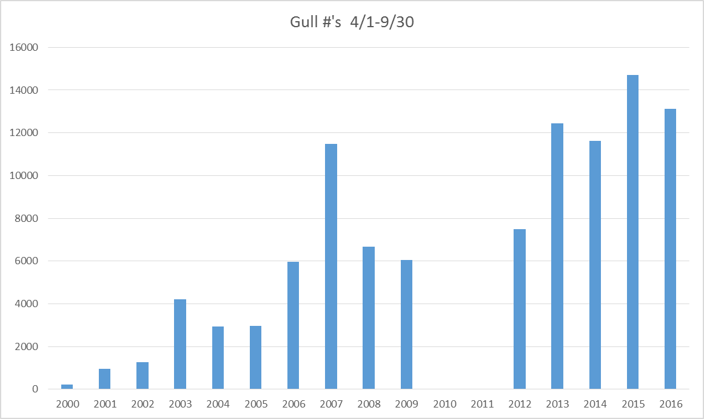
The Dalles Total Gull Trend

Slide 9
The Dalles Weekly Max Gull Trend

Slide 10
John Day Gull Trend

Slide 11
Past Research
Fish Field Unit 2009-2011
  Field observation at the The Dalles and John Day Dams
  Estimate consumption rate and location
  Compare years
  Conclusion;
    Predation changes between years
    Changes due to natural variation (population/river flow) and not deterrent efforts at dams
    John Day 2011 consumption estimate 0.02% total outmigration all species combined
    The Dalles consumption ~2.5X John Day – Still <1% outmigration

Slide 12
Present Research
Inland Avian Predation Work Group
  USGS, OSU and RTR survey nest colonies. PIT and population
  Miller population 3500-6000. Average size in 2016.
  PIT measured from McNary. PIT trend not available.
  Goal <2% salmonid take per colony
  2015 consumption estimate 7.4% SR sockeye, 9.7% SR steelhead,13.2% UCR steelhead (8.3-21.1)
  2016 consumption listed species estimate 6.4% SR sockeye, 6.7% SR steelhead and 10.1% UCR steelhead
  Recommended managing Miller gulls to achieve IAPMP goal
  “Predation rates by Miller rocks gulls were particularly alarming”

Slide 13
BiOp Survival Maintained?
BiOp >96% spring survival = <4% loss
All PIT recovery results >4% loss
Does not account for piscivorous fish or other bird predation
Evidence indicates majority gulls at The Dalles
Are we maintaining BiOp requirements?

Slide 14
Options
Modify habitat
Hazing and avian line improvements
Lethal removal

Slide 15
Other Lethal Abatement
East Sand Island Cormorants (3.5% steelhead)
Bonneville Sea Loins (Trigger number?)
NWW lethal gulls (authorized purpose?)
PUDs lethal gull?
Northern Pike Minnow since 1991 (10-20% reduced exploitation = 35% predation reduced)

